Slide 1
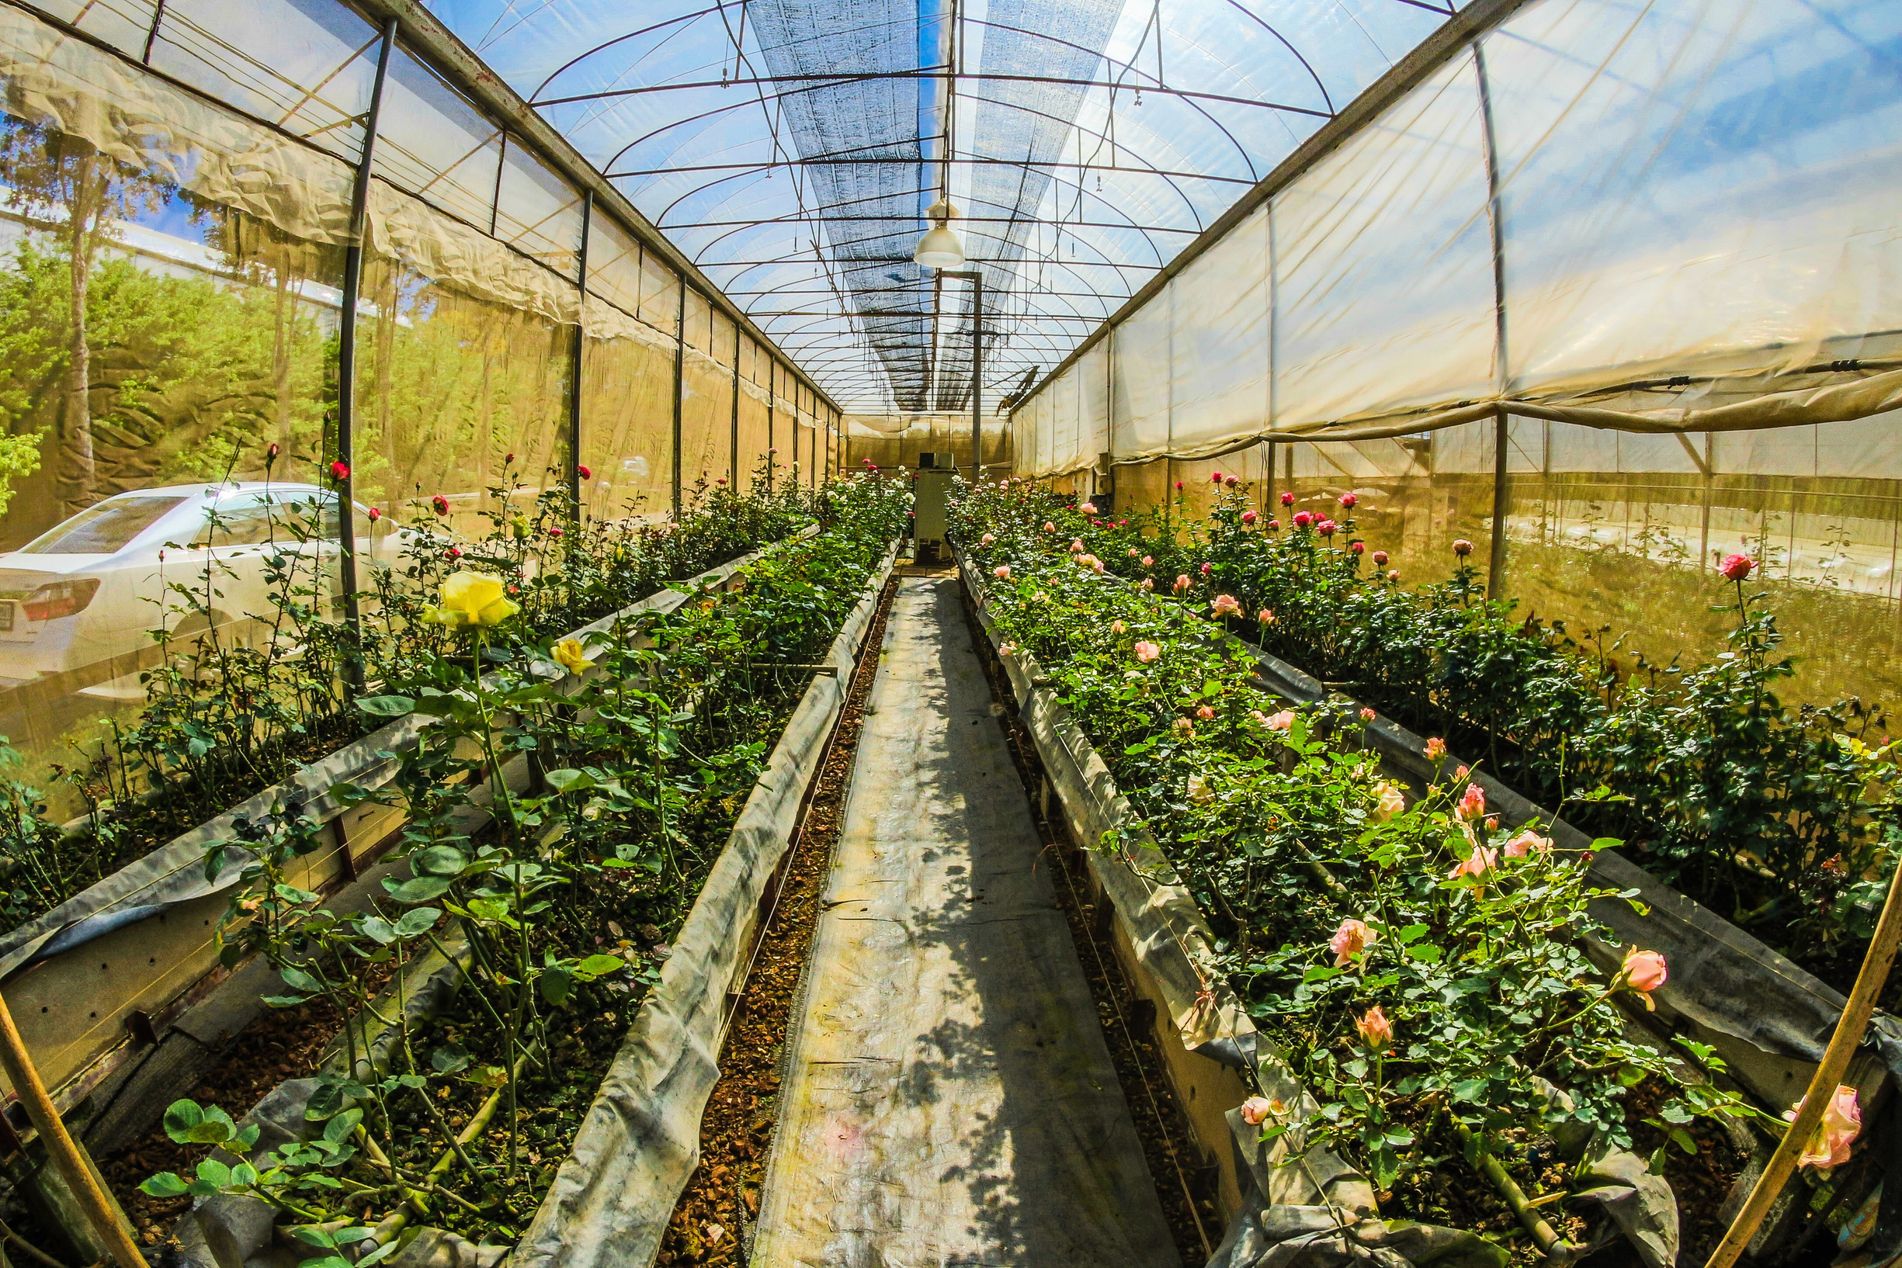


Deep Learning
Tomato Disease Classifier with Convolutional Neural Network
By Fatima Alharbi

Slide 2
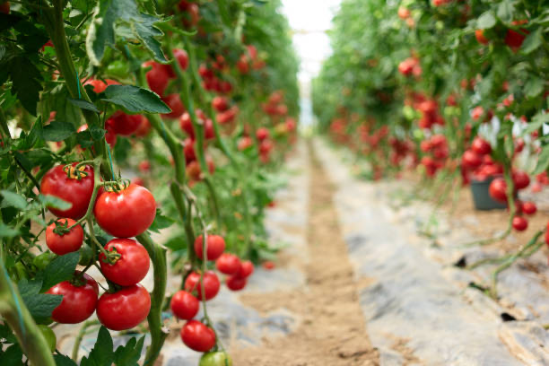
Table of Contents:
Introduction and Motivation
Stages of Implementing
Data Collecting
Data Visualization
Model Building
Model Architecture
Model Accuracy
Model testing
Model Deployment
Future Scope

Slide 3


Motivation

Slide 4

Stages of Implementing
Methodology
Data Collecting
Data Visualization
Model Deployment as API
Convolutional Neural Network
LEARN MORE

Slide 5
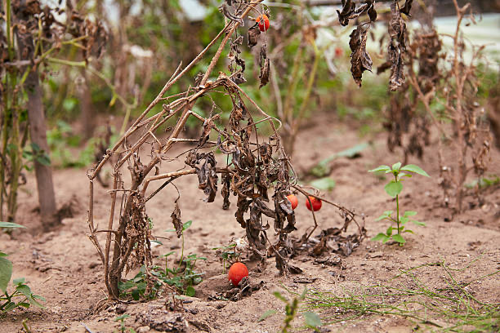

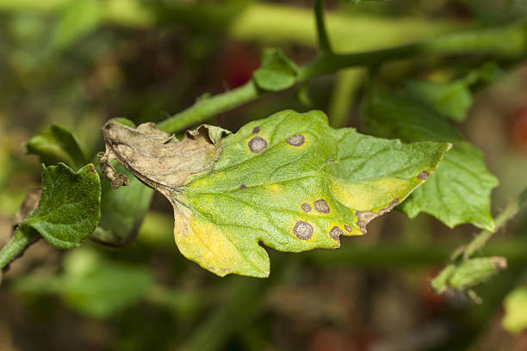
Data Collecting
Dataset Contains 10 classes.
Nine types of Tomato disease &healthy leaf.
Total 27,000 pictures.

Slide 6
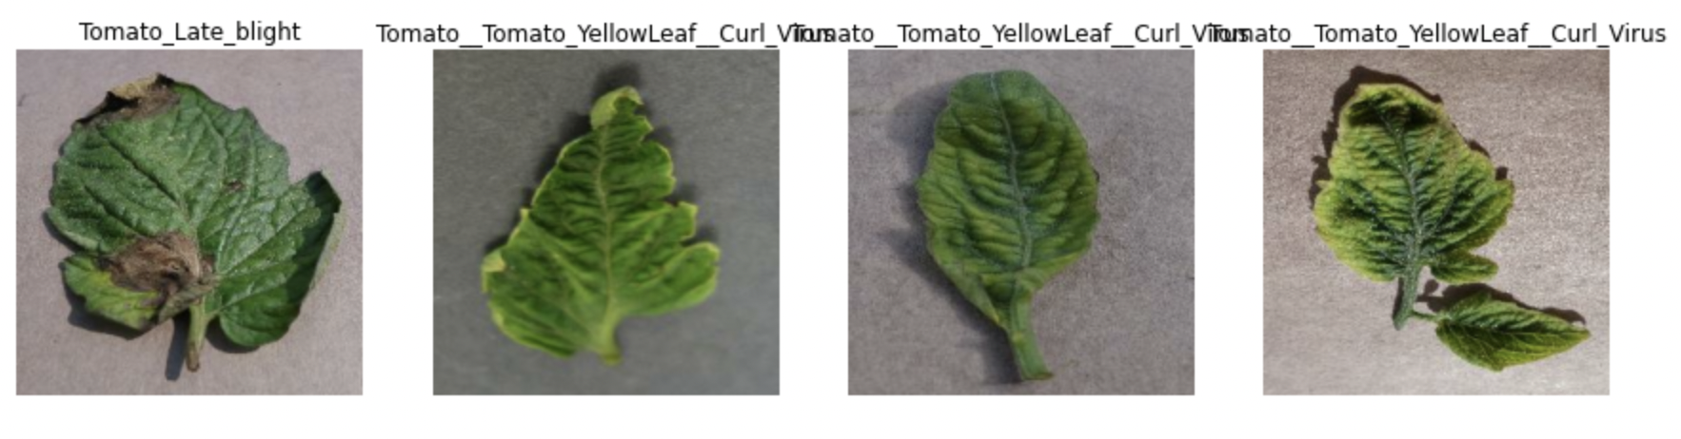
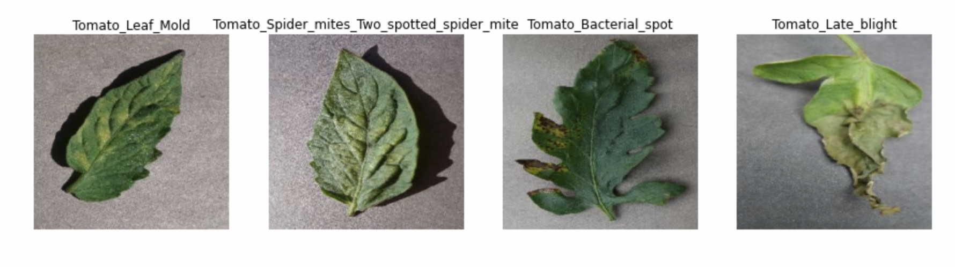
Data Visualization

Slide 7
Building Model
Layers Creation
Data Augmentation
Model Architecture
Compiling The Model

Slide 8

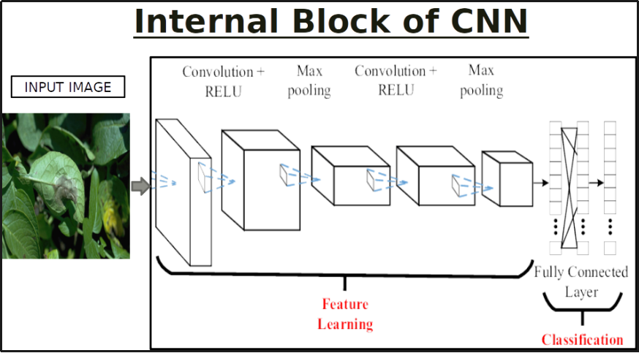
Model Architecture

Slide 9
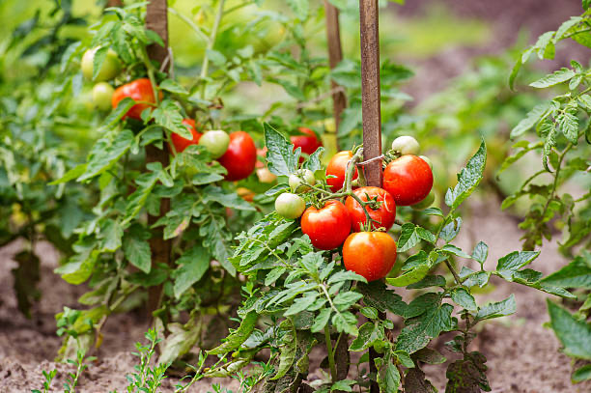
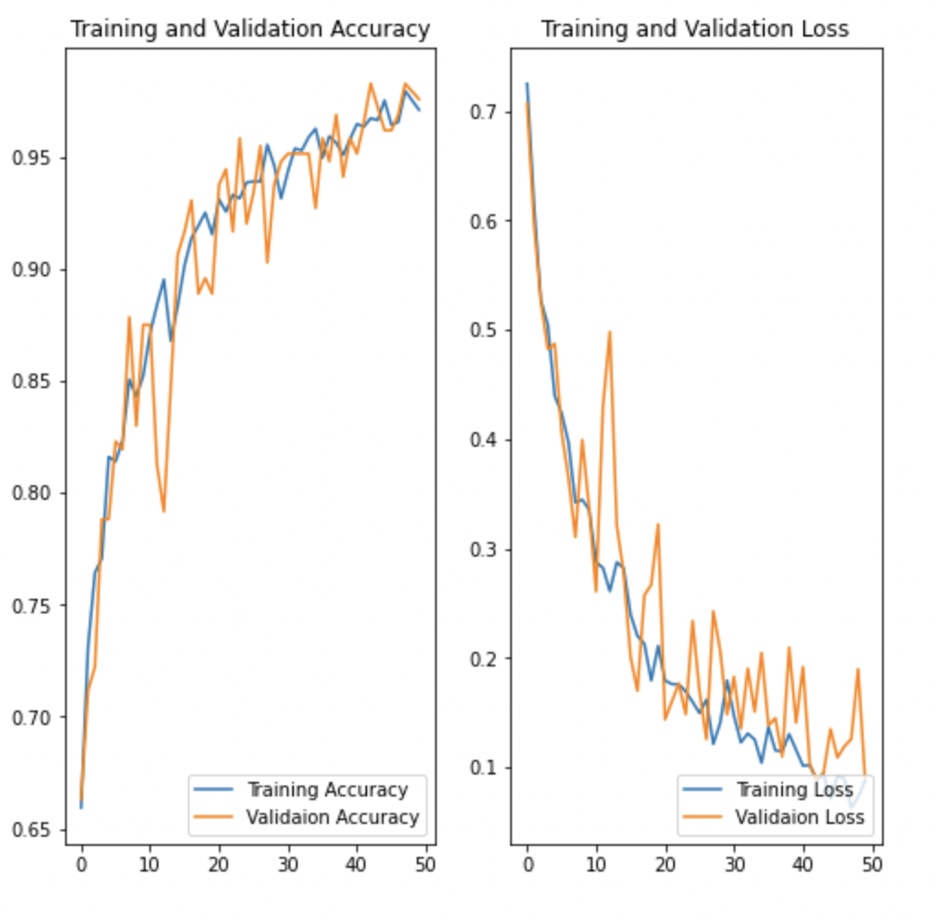
Model Accuracy & loss

Slide 10
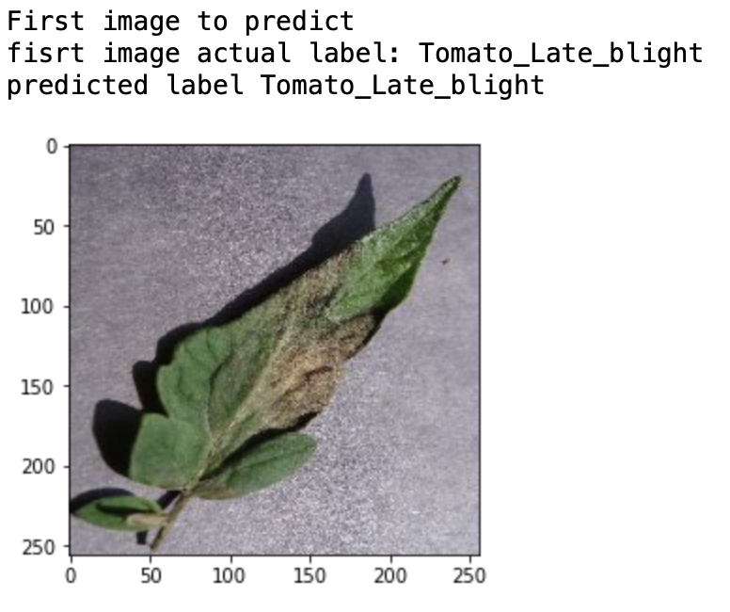
Prediction on a sample

Slide 11
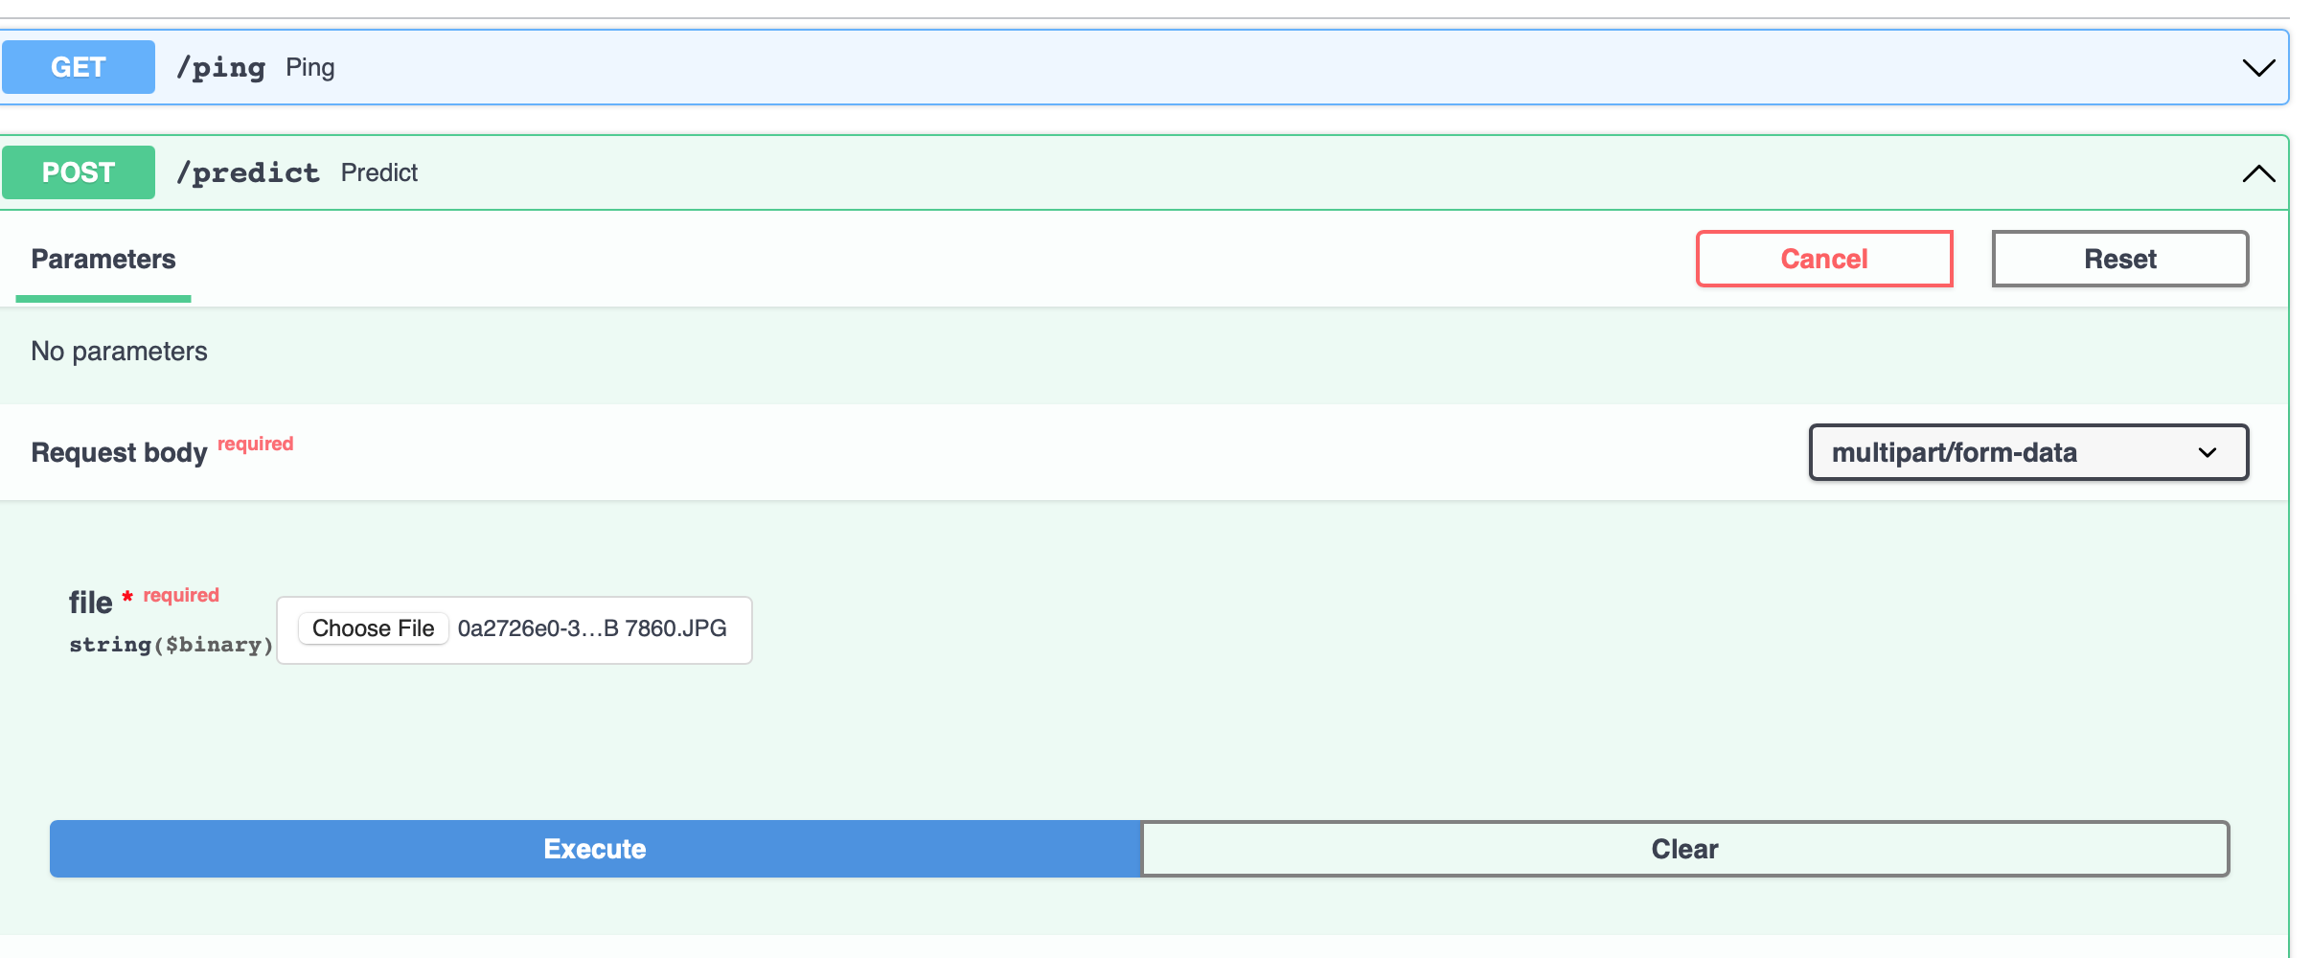
Deploy as API

Slide 12
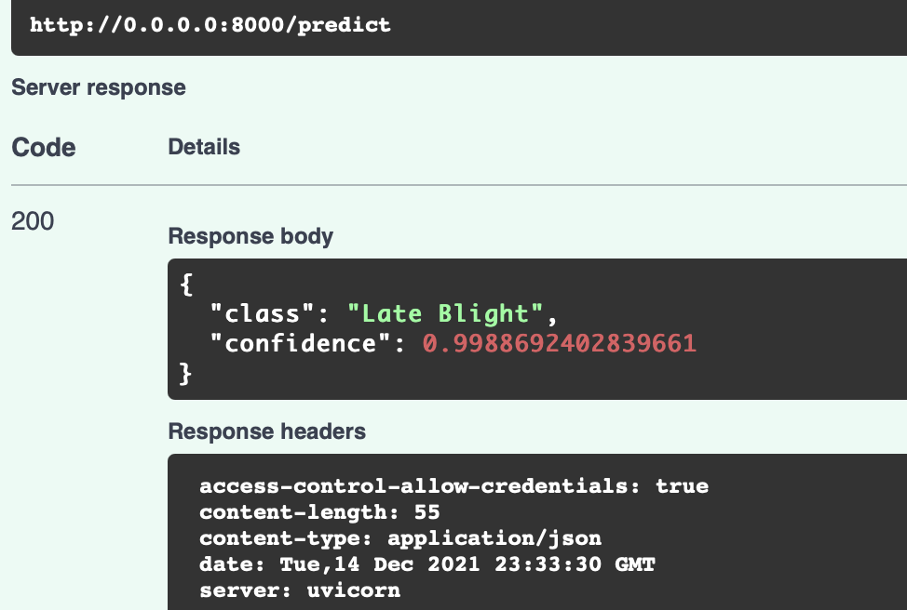
Deploy as API

Slide 13
Future Scope
Build a mobile app with CNN model
Deploy Deep learning Models on IoT Devices

Slide 14
THANK YOU

Slide 15
References:
Dataset: https: www.kaggle.com/emmarex/plantdisease
Saudi Vision: https://www.vision2030.gov.sa/v2030/a-sustainable-saudi-vision/
TensorFlow-IoT: https://www.tensorflow.org/lite
Project code: https://github.com/FatimaAlharbi/SDAIA-DataScience-bootcamp.git

